Slide 1
Implicit Syntax for Targeted Sentiment Analysis
Yuze Gao, Yue Zhang and Tong Xiao
November 27, 2017, TaiWan

Slide 2
Outline
Background
Our Method
Experiments and Results
Conclusion

Slide 3
Outline
Background
Our Method
Experiments and Results
Conclusion

Slide 4
Background
Targeted Sentiment Analysis
Given a sentence s_{n} with target words t_{m} , we judge the sentiment(positive, negative, neutral) of the sentence towards the target words t_{m} .
Target Context (Duy-Tin Vo and Yue Zhang 2015)
Left Context
t_{m}
Right Context
The food in Cafe Owl is more delicious than that in Cathy’s .
s_{n}
Positive

Slide 5
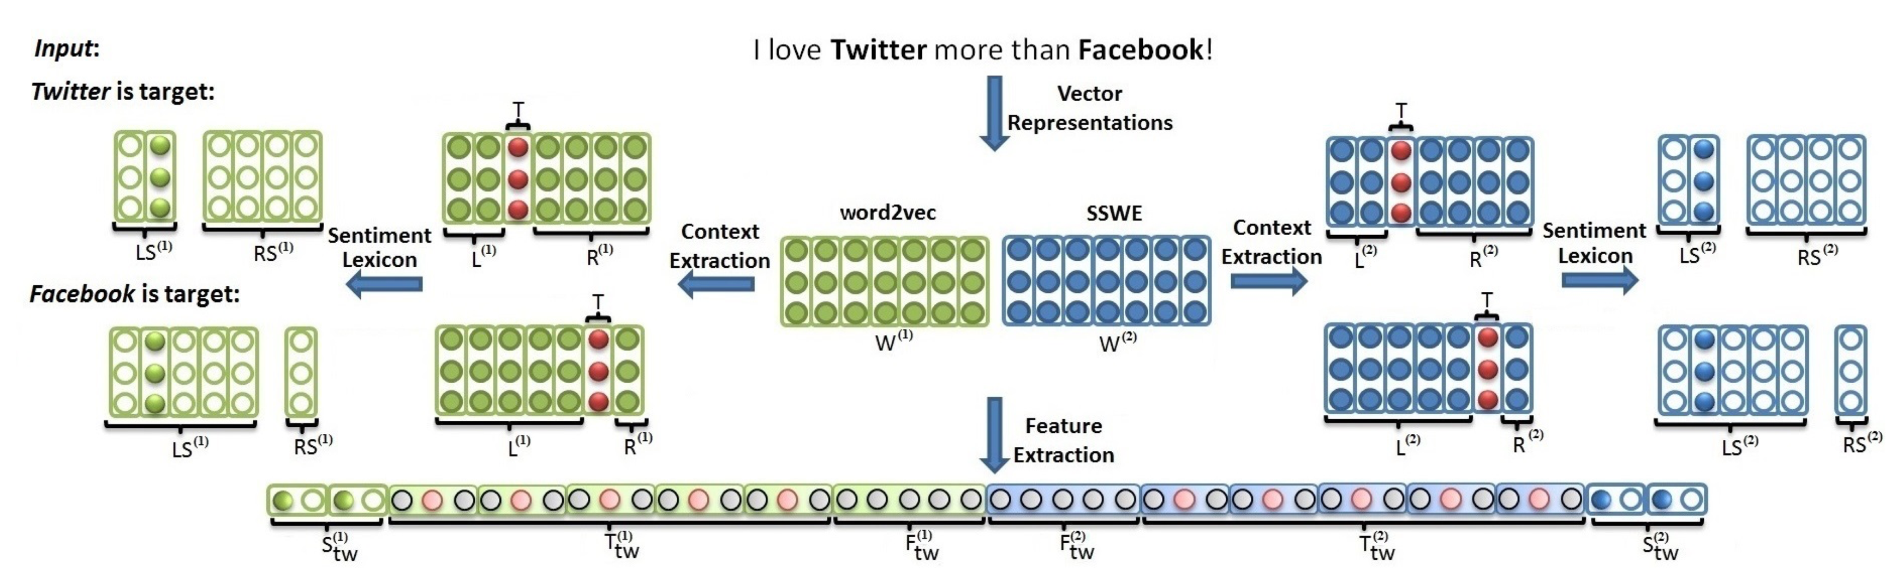
Background
Baselines:
Vo and Zhang (2015)
Duy-Tin Vo and Yue Zhang. 2015. Target-dependent twitter sentiment classification with rich automatic features. In IJCAI. pages 1347–1353

Slide 6
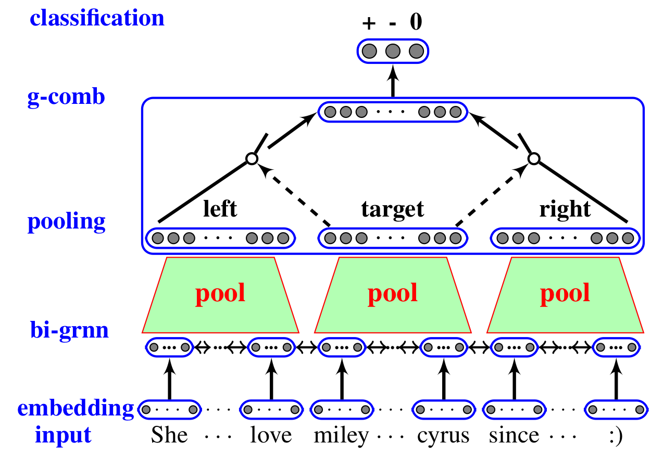
Background
Baselines:
Zhang et al. (2016)
Meishan Zhang, Yue Zhang, and Duy-Tin Vo. 2016. Gated neural networks for targeted sentiment analy- sis. In AAAI. pages 3087–3093.

Slide 7
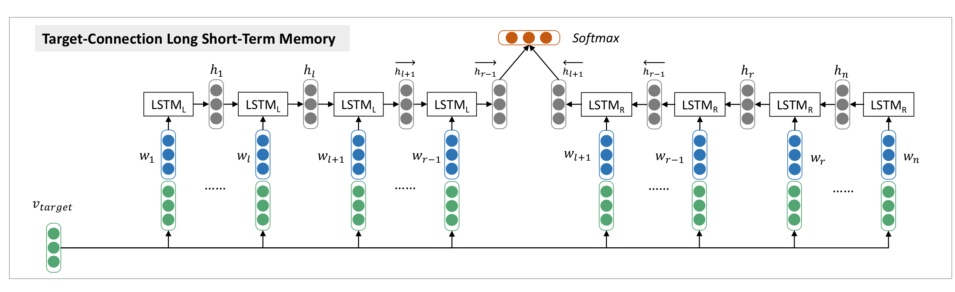
Background
Baselines:
Tang et al. (2016)
Duyu Tang, Bing Qin, Xiaocheng Feng, and Ting Liu. 2016. Effective lstms for target-dependent sentiment classification. In COLING. pages 3298–3307.

Slide 8
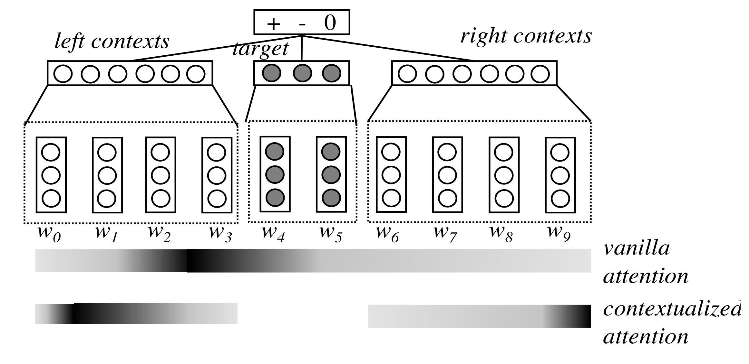
Background
Baselines:
Liu and Zhang (2017)
Jiangming Liu and Yue Zhang. 2017. Attention mod- eling for targeted sentiment. EACL 2017 page 572.

Slide 9
Background
Baselines:
Results

Slide 10
Background
Syntax information should help improve targeted sentiment analysis
Purpose: how to utilize the syntax information properly
implicit methods
Sentiment
Syntax
Information
OR
Sentiment
Analysis
explicit methods

Slide 11
Background
Directly using parser output suffer noise and error propagation
implicit methods
Sentiment
Syntax
Information
OR
Sentiment
Analysis
explicit methods

Slide 12
Our Method
Model Structure

Slide 13
Our Method
Model Structure
Pre-trained

Slide 14
Our Method
POS-tagging model
t_{n}
t₁
t₂
… tags …
t_{n-1}
… classifier layer …
l₁
l₂
l_{n-1}
l_{n}
h₁
h₂
bilstm layers
h_{n-1}
h_{n}
… inputs layer …
x₁
x₂
x_{n-1}
x_{n}
… words …
w₁
w_{n-1}
w₂
w_{n}

Slide 15
Our Method
POS-tagging model
t_{n}
t₁
t₂
… tags …
t_{n-1}
… classifier layer …
l₁
l₂
l_{n-1}
l_{n}
Implicit POS-tag features
h₁
h₂
bilstm layers
h_{n-1}
h_{n}
… inputs layer …
x₁
x₂
x_{n-1}
x_{n}
… words …
w₁
w_{n-1}
w₂
w_{n}

Slide 16
Our Method
POS-tagging model
t_{n}
t₁
t₂
… tags …
t_{n-1}
… classifier layer …
l₁
l₂
l_{n-1}
l_{n}
Explicit POS-tag features
h₁
h₂
bilstm layers
h_{n-1}
h_{n}
… inputs layer …
x₁
x₂
x_{n-1}
x_{n}
… words …
w₁
w_{n-1}
w₂
w_{n}

Slide 17
Our Method
Dependency model
S₁^{1:n}
S₂^{1:n}
……
S_{n-1}^{1:n}
S_{n}^{1:n}
CLF
CLF
……
CLF
CLF
A
D
A
D
Learned Fetures
A
D
A
D
MLP
MLP
MLP layers
MLP
MLP
h₁
h₂
Bi-LSTM layers
h_{n-1}
h_{n}
W
T
W
T
Features
W
T
W
T
Timothy Dozat and Christopher D Manning. 2016. Deep biaffine attention for neural dependency pars- ing. arXiv preprint arXiv:1611.01734 .

Slide 18
Our Method
Dependency model
S₁^{1:n}
S₂^{1:n}
……
S_{n-1}^{1:n}
S_{n}^{1:n}
CLF
CLF
……
CLF
CLF
A
D
A
D
Learned Fetures
A
D
A
D
Implicit dependency features
MLP
MLP
MLP layers
MLP
MLP
h₁
h₂
Bi-LSTM layers
h_{n-1}
h_{n}
W
T
W
T
Features
W
T
W
T
Timothy Dozat and Christopher D Manning. 2016. Deep biaffine attention for neural dependency pars- ing. arXiv preprint arXiv:1611.01734 .

Slide 19
Our Method
Dependency model
S₁^{1:n}
S₂^{1:n}
……
S_{n-1}^{1:n}
S_{n}^{1:n}
CLF
CLF
……
CLF
CLF
Implicit dependency features
A
D
A
D
Learned Fetures
A
D
A
D
MLP
MLP
MLP layers
MLP
MLP
h₁
h₂
Bi-LSTM layers
h_{n-1}
h_{n}
W
T
W
T
Features
W
T
W
T
Timothy Dozat and Christopher D Manning. 2016. Deep biaffine attention for neural dependency pars- ing. arXiv preprint arXiv:1611.01734 .

Slide 20
Our Method
Top Sentiment Model
P
Classifier
∑(V₁:V_{n})
V₁
V₂
V_{i}
V_{j}
V_{n-1}
V_{n}
⦿
⦿
⦿
⦿
⦿
⦿
α₁
α₂
……
α_{i}
α_{j}
……
α_{n-1}
α_{n}
⊕
⊕
⊕
⊕
⊕
⊕
h_{t}
h₁
h₂
h_{i}
h_{t1}
Bi-LSTM Layers
h_{tm}
h_{j}
h_{n-1}
h_{n}
w
w
……
w
w
……
w
w
……
w
w
Implicit Features and Word-embeddings
b
b
b
b
b
b
b
b

Slide 21
Outline
Background
Our Method
Experiments and Results
Conclusion

Slide 22
Experiments and Results
Dataset
PTB3 [standard splits]
Z-Set [Zhang et al. (2016)]
T-Set [Tang et al. (2015)]
Meishan Zhang, Yue Zhang, and Duy-Tin Vo. 2016. Gated neural networks for targeted sentiment analysis. In AAAI. pages 3087–3093.
Duyu Tang, Bing Qin, Xiaocheng Feng, and Ting Liu. 2015. Effective lstms for target-dependent sentiment classification. In COLING. pages 3298–3307.

Slide 23
Experiments and Results
Dataset
Test Set sentence length distribution

Slide 24
Experiments and Results
The Results of Bottom syntactic Model(Pre-trained part)

Slide 25
Experiments and Results
Results of test set with different implicit syntax features

Slide 26
Experiments and Results
F1 values of each polarity on test set

Slide 27
Experiments and Results
Test set F1 values against sentence length(Z-Dataset)

Slide 28
Conclusion
Implicit syntax features by neural stacking method can obviously help enhance the targeted sentiment analysis.
POS-tagging features can carry more positive implicit information that help short sentence.
Dependency implicit features show robust and stable in different sentence length.

Slide 29
Thank you!
Code is available at https://github.com/CooDL/TSSSF

